Slide 1
MPG
I2C + LCD

Slide 2
Housekeeping
Attendance
Next 2-3 weeks, potential topics:
Beeper, LED, Button
SD Card (file system)
Text Editor
Radio (ANT)
Debug (USB), PC-Lint (makefiles)
End Project

Slide 3
What is an LCD?
Liquid Crystal Display
Basically works by polarizing individual segments to allow light to either reflect (“off” = light) or be absorbed (“on” = dark)
Usually have to be continually refreshed (newer E-ink and bi-stable LCDs are changing that)

Slide 4
LCD Controller
Reduce pin count on processor
May offload complexity

Slide 5
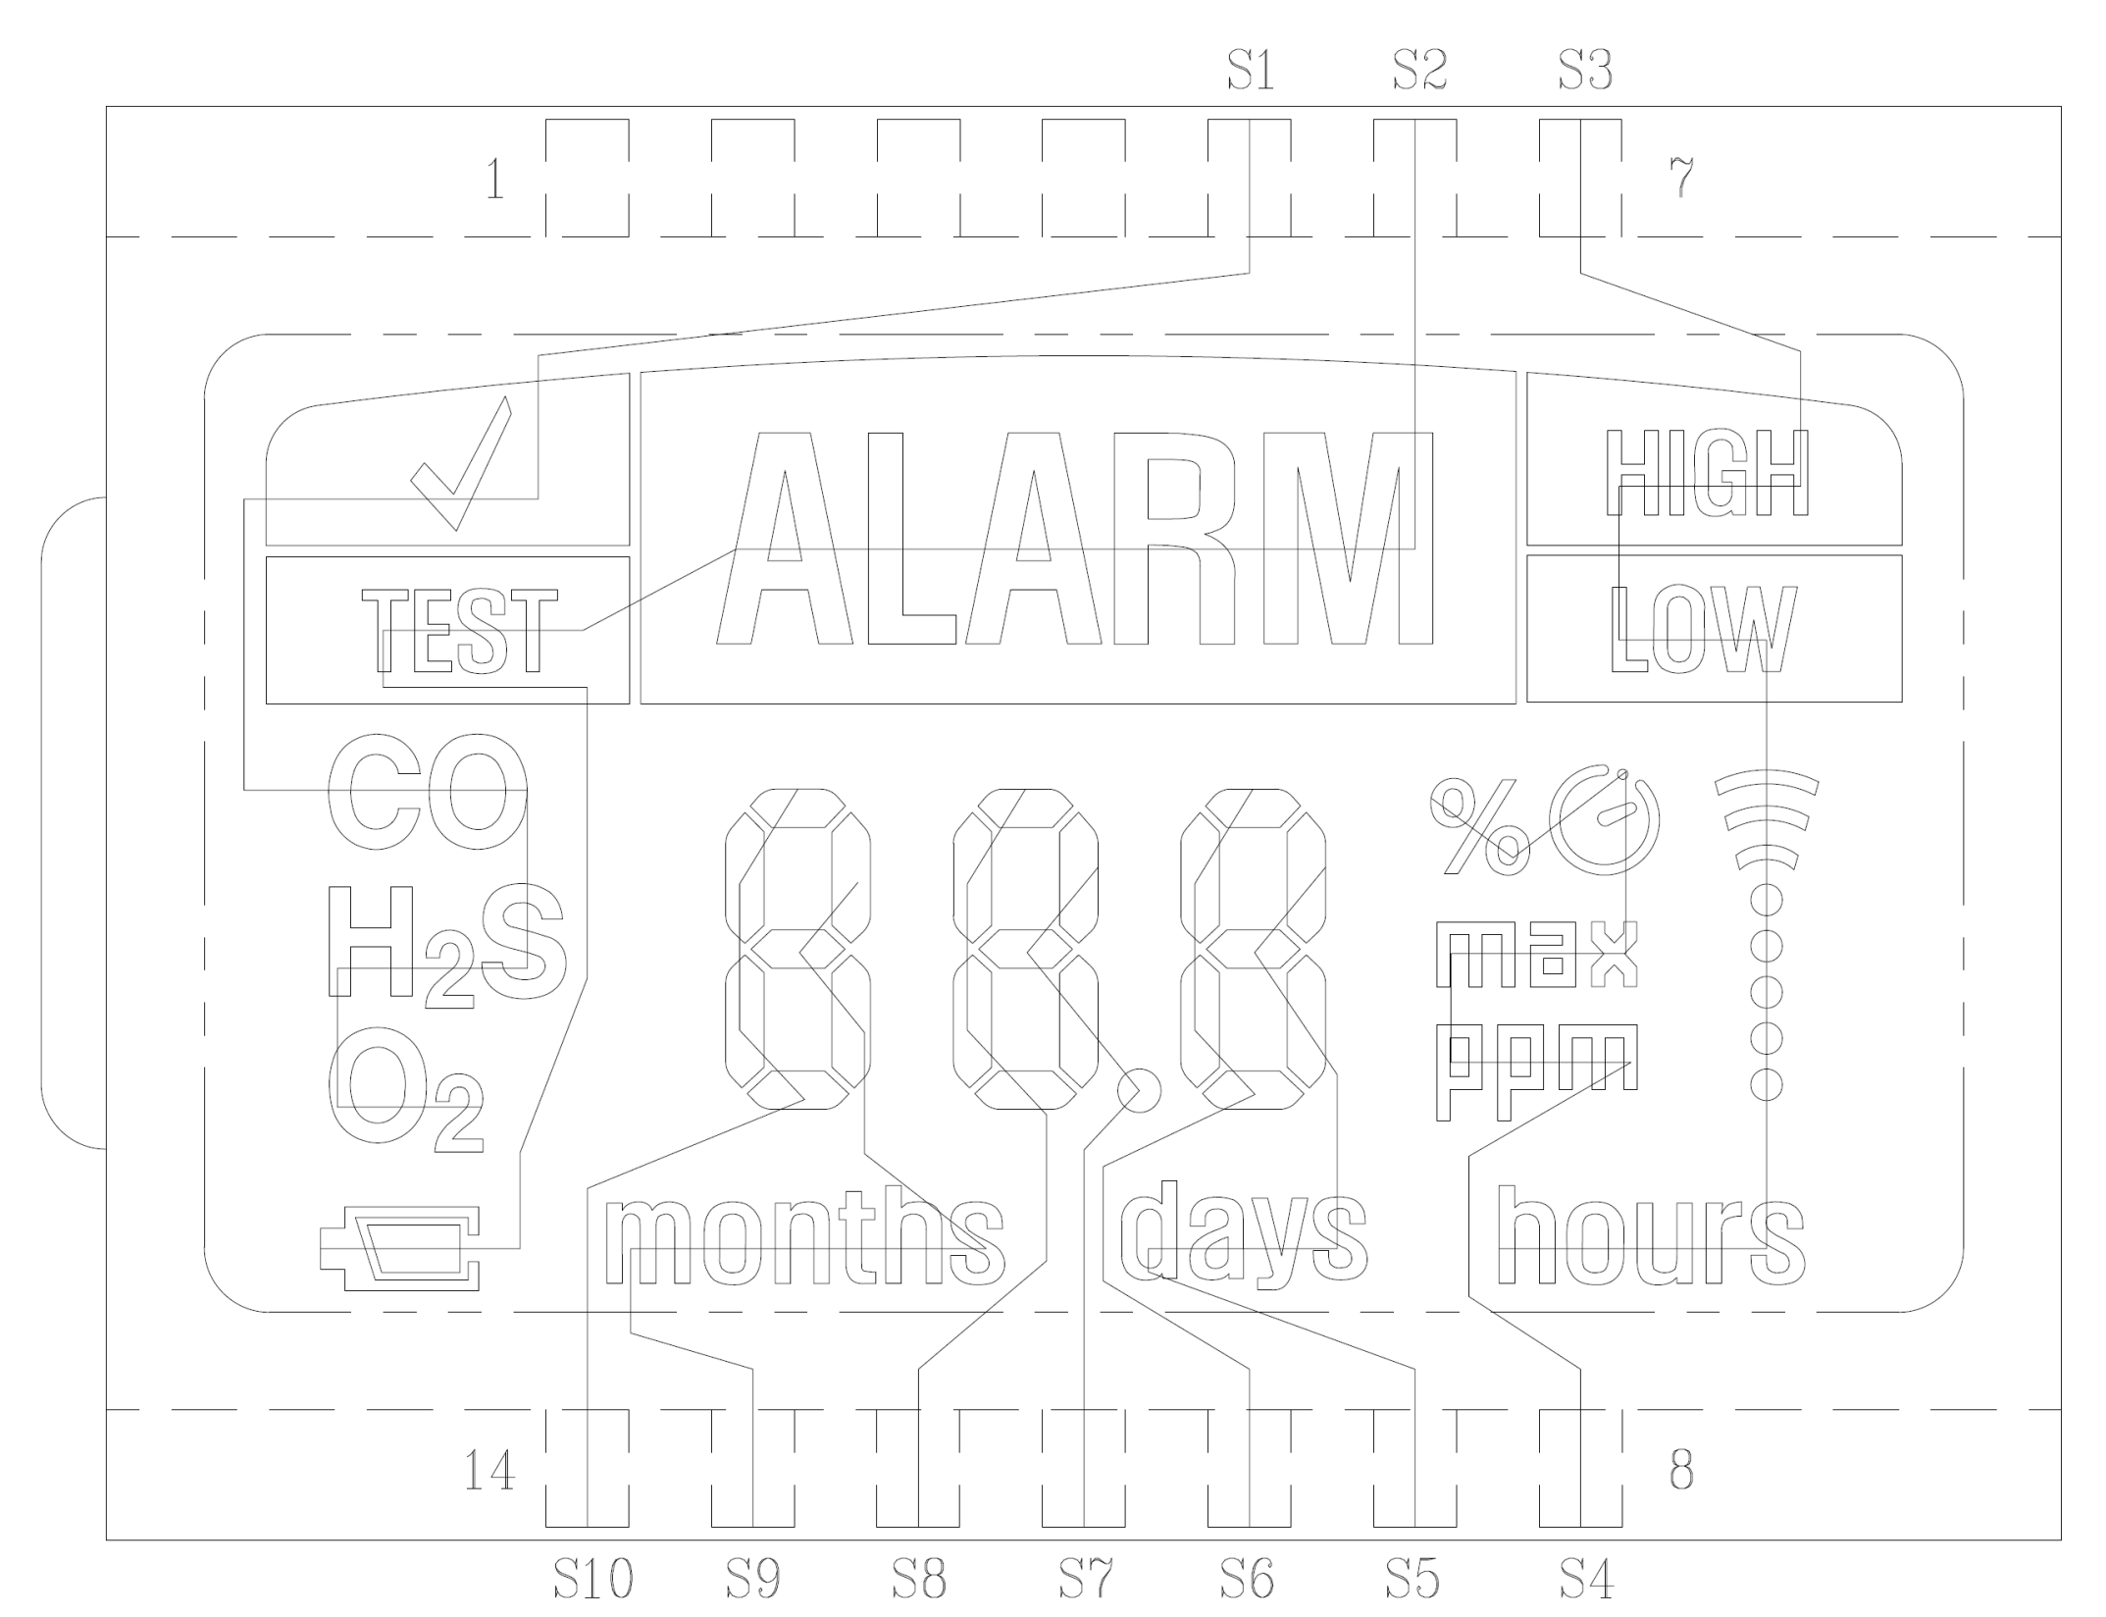

Slide 6
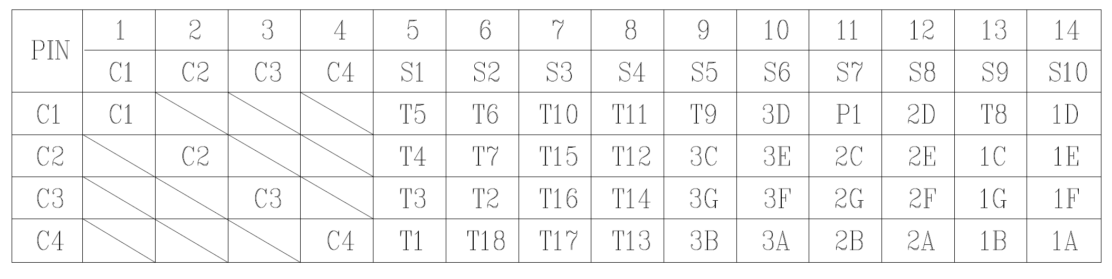
LCD Pinout

Slide 7
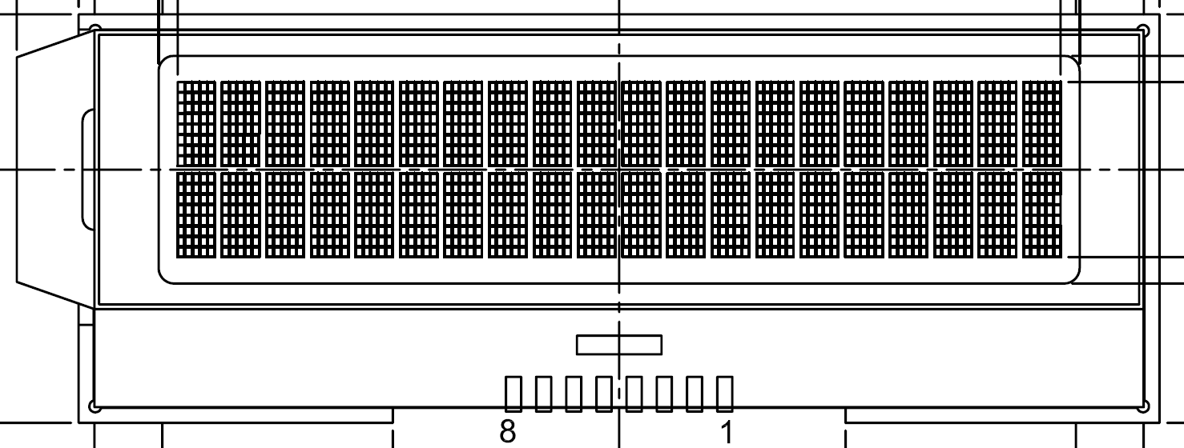
MPG LCD
2 lines x 20 chars
Each character is 5x8
5x8x20x2 = 1600 pixels.
16 COM lines means 116 pins (100 + 16 COM)

Slide 8
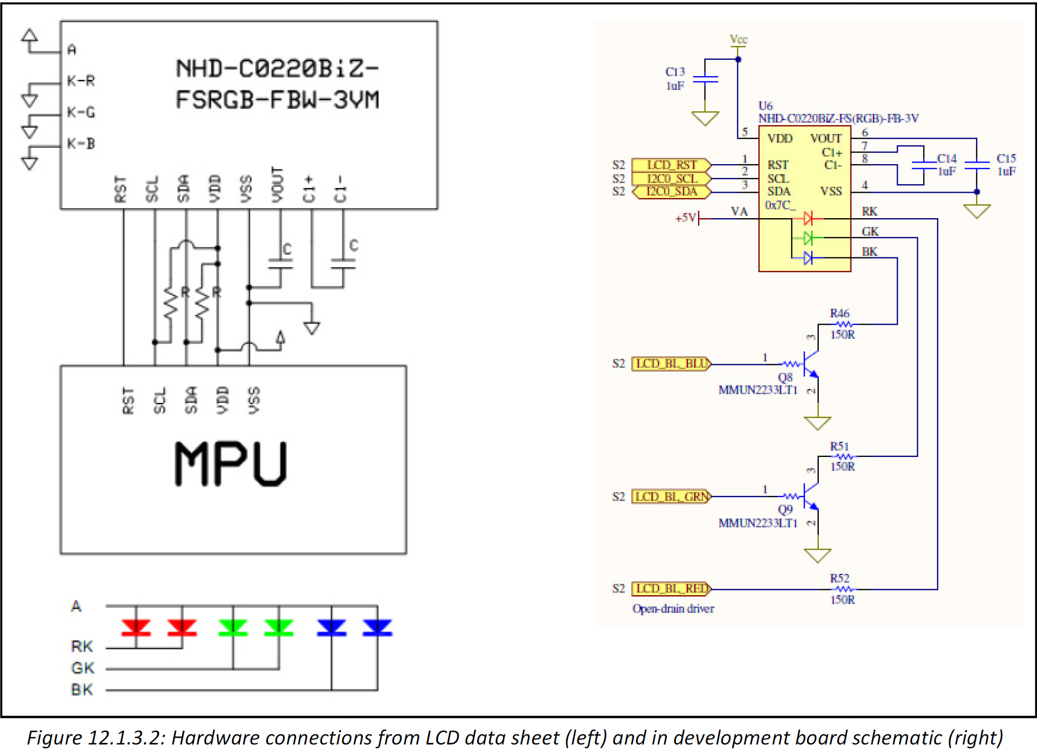
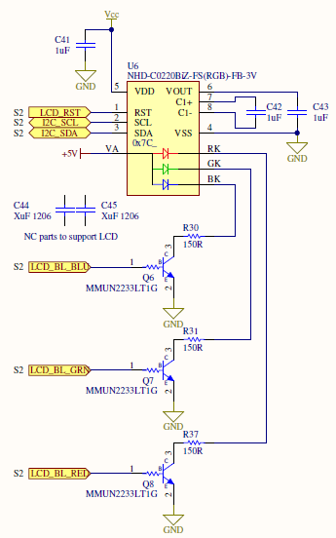
MPG Hardware

Slide 9
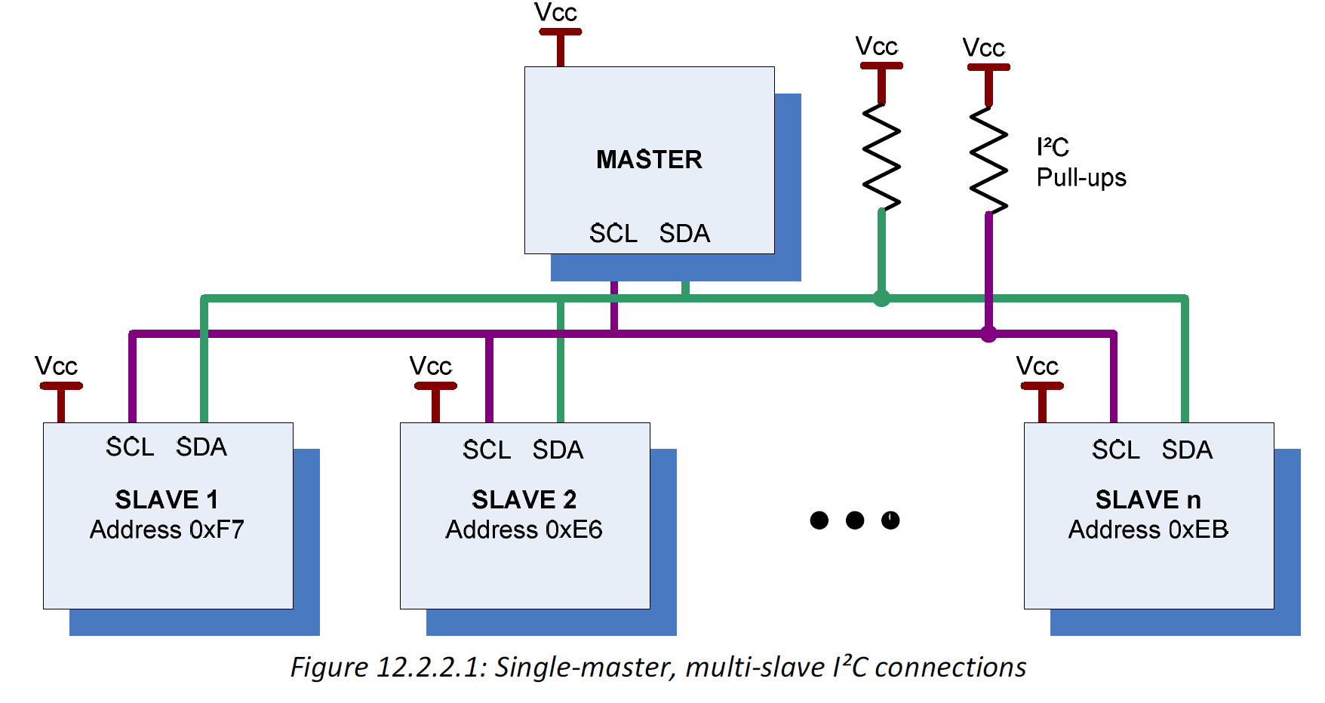
I²C
Notes:
Nobody drives the SCL/SDA lines high – they let the pull-up resistors bring the lines to VCC instead. That way you can’t have two people driving opposite signals to each other (short)

Slide 10
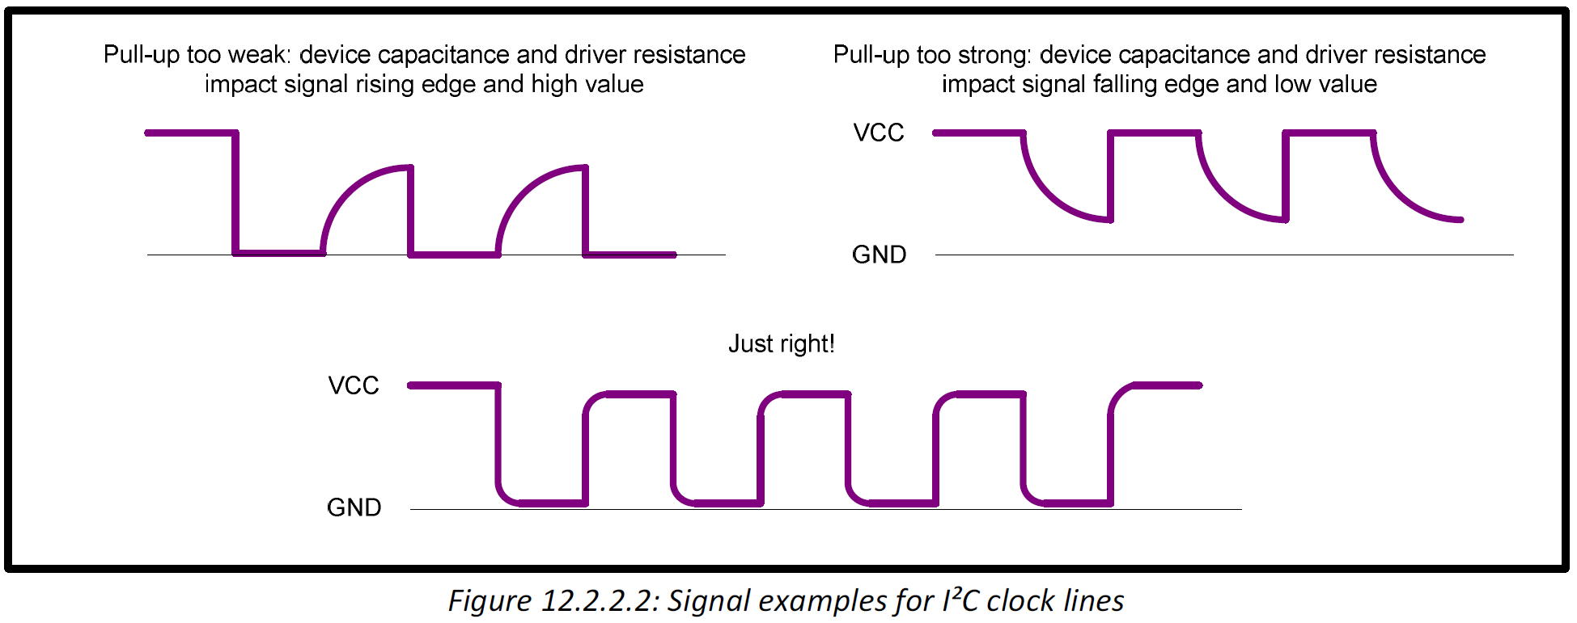
I2C Signals

Slide 11
I²C
(SDA)
(SCK)

Slide 12
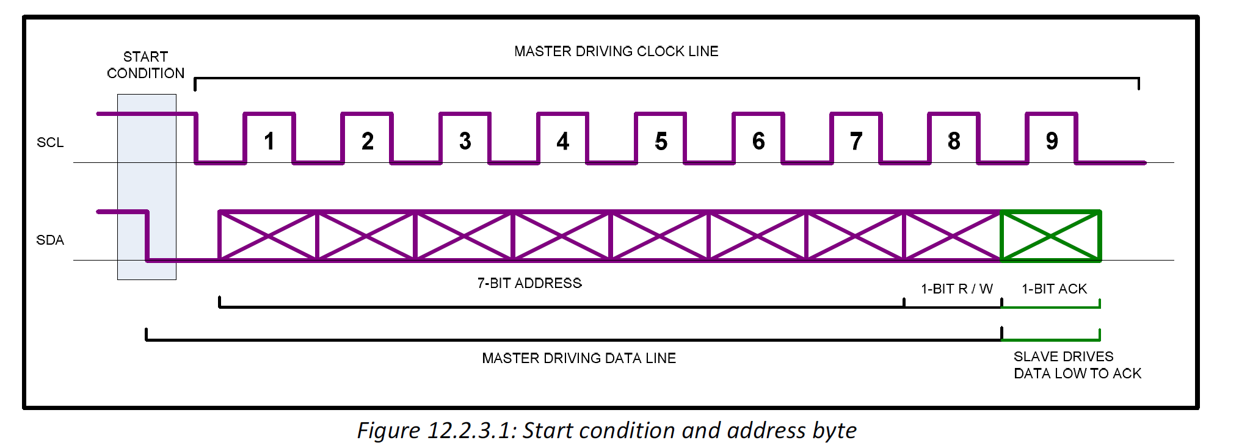
I2C Addressing

Slide 13
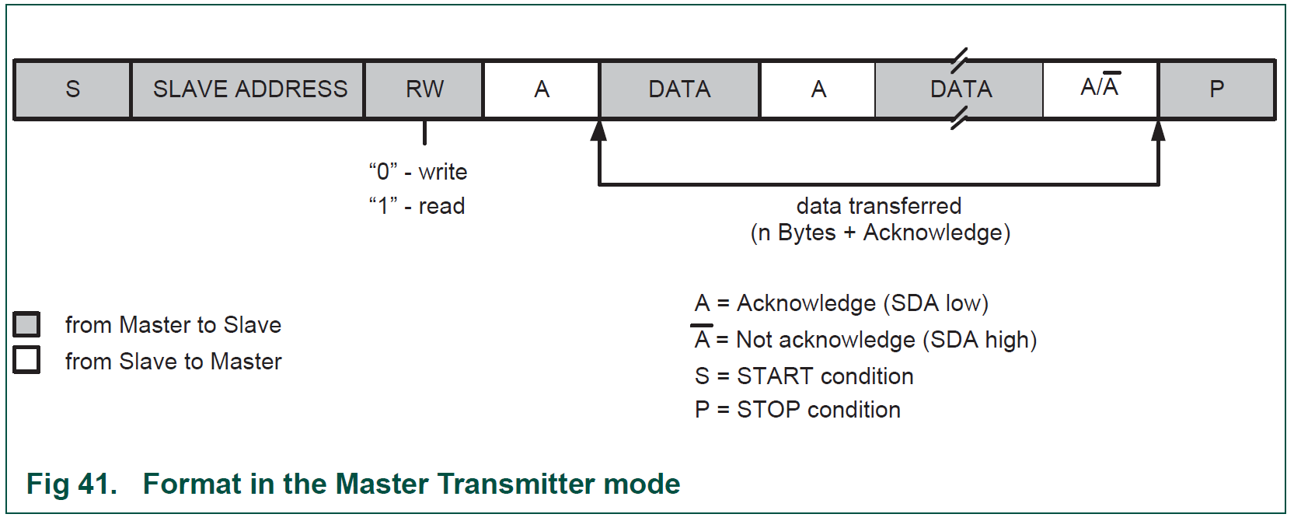
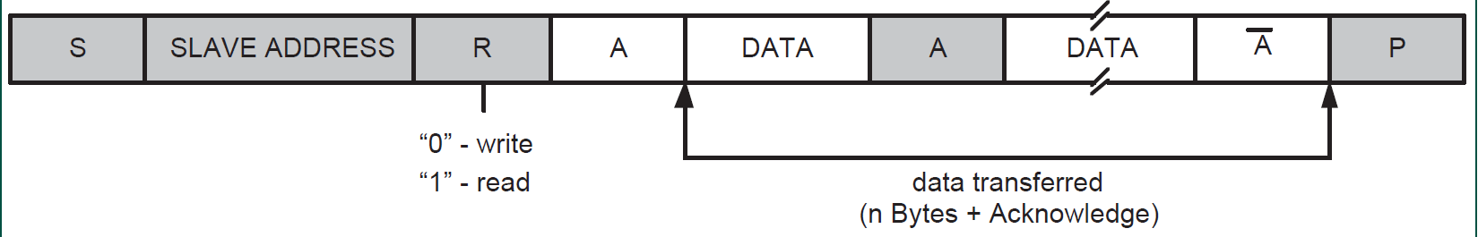
I2C Transmission

Slide 14
I²C Driver
I2cOpen(port, speed, IRQ callbacks)
I2cClose(port)
I2cWriteReadWait(port, params)
(Alternatively: WriteRead + IsBusy)
Params =
Address
TX data + length
(RX buffer + length)

Slide 15
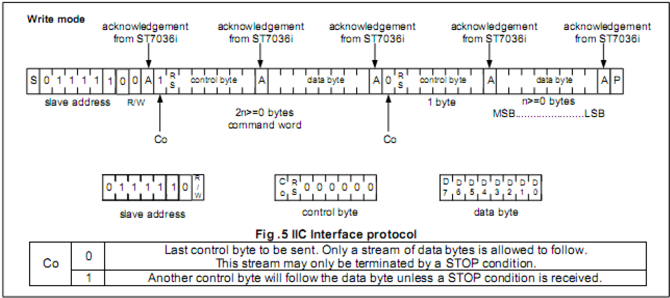
LCD Communication

Slide 16
LCD
I2C Address
Control Byte
Character RAM addresses
LCD command set
LCD initialization sequence

Slide 17
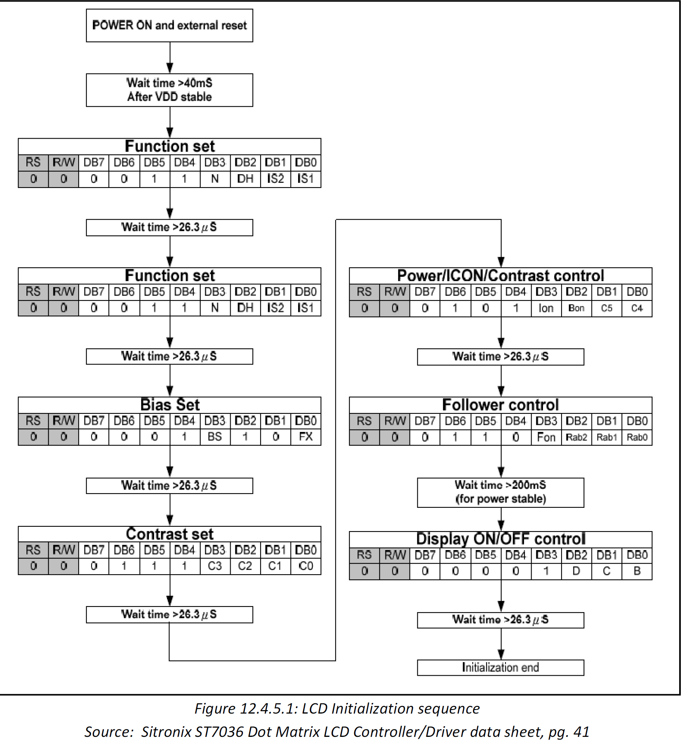

Slide 18
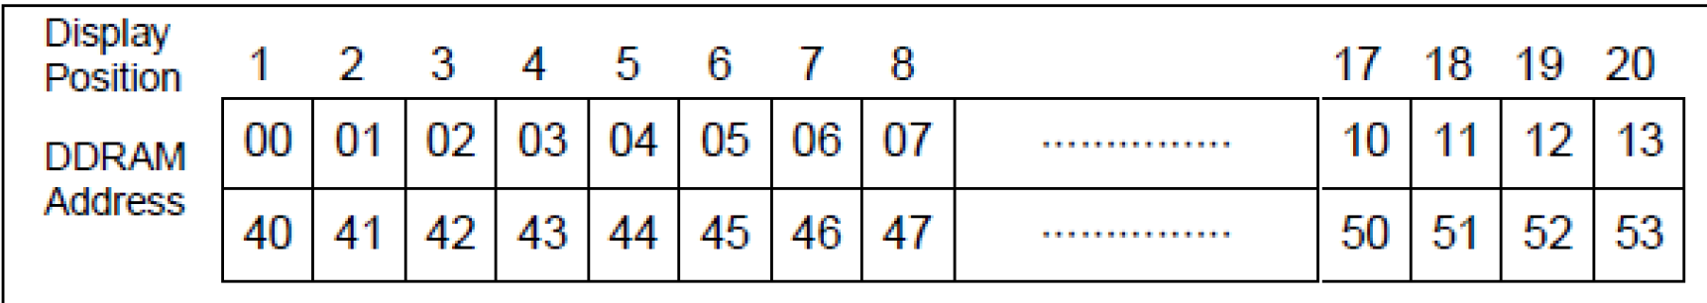
LCD Character RAM
Line 1 (row 0 in code) = 0x00 to 0x13
Line 2 (row 1 in code) = 0x40 to 0x53

Slide 19
LCD Characters

Slide 20
LCD driver
Init()
ConfigSet(on/off, cursor on/off, blink on/off, contrast, height=1 or 2)
SetPosition(row, column)
Clear()

Slide 21
LCD Driver (cont’d…)
Putc(character)
Puts(String)
Printf(String, …)
Write(String, length)
Update()

Slide 22
You’re Turn!
https://xp-dev.com/svn/MPG/SAM3U/MPGL1/Exercises/Lcd
void LcdSetPos(u8 row, u8 col);
void LcdClear(void);
void LcdPutc(char c);
void LcdPuts(char const *pSrc);
void LcdPrintf(char const *pSrc, ...);

